Slide 1

POL 180 Intro to Policy Analysis
Case study:
Expanded access to experimental medical therapies
Dr. Ken Menkhaus
Davidson College
Fall 2021

Slide 2
Pedagogical goals for this case
Value trade-offs
Ethical dilemmas of patient advocacy
The law of unintended consequences
Issue framing
Complexity
Political economy
Prospects for and limits of public mobilization on policy issues

Slide 3
Problem statement
People with untreatable, fatal diseases want access to experimental therapies, but a variety of factors make that difficult. What policies could make expanded access (EA) more feasible, efficient, effective, and fair?

Slide 4
Context
Therapies developed in a regulated market context – profit-driven
How drugs and therapies are developed to slow, stop, or cure diseases – the pipeline
Clinical trials, how, why, who?
Main actors: research institutes, pharma companies, advocacy groups, National Institutes of Health (NIH), Food and Drug Administration (FDA), patients.
Costs of trials, implications
Regulatory process – standards of evidence, FDA approval, conditionality approval
Survivable vs incurable diseases
Neurological diseases and problem of causality
Disease heterogeneity and difficulty of measuring impact
Despite billions spent, no significant therapy development in any neurological disease – we’re batting zero

Slide 5
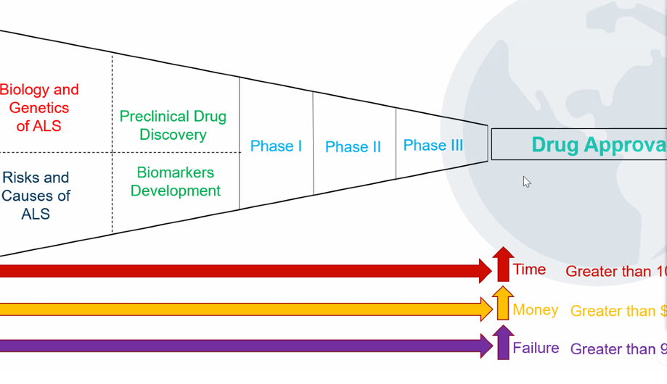
Pipeline

Slide 6
What is expanded access?
Expanded access, also known as "compassionate use", is the use of an investigational new drug or biologic to treat a patient with a serious or life-threatening disease or condition who does not meet the enrollment criteria for a clinical trial in progress or have alternative therapies available
“nothing to lose;” FDA is “protecting me to death”
Current policies:
FDA compassionate use or expanded access process, individual requests
Drug company must also agree
Why do they often not agree? Cost; availability; ethics (fairness to placebo group); risk
Result: few get expanded access; most of those who do are those who can afford enormous costs

Slide 7
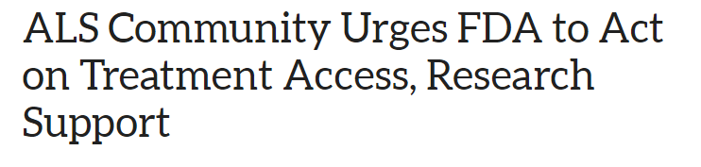
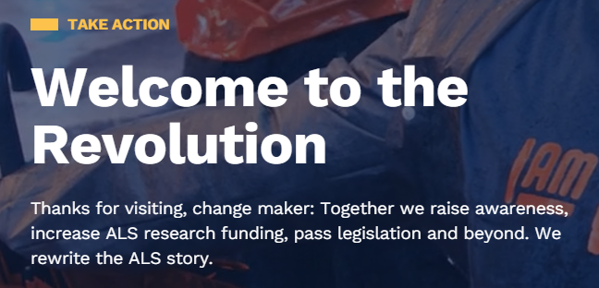
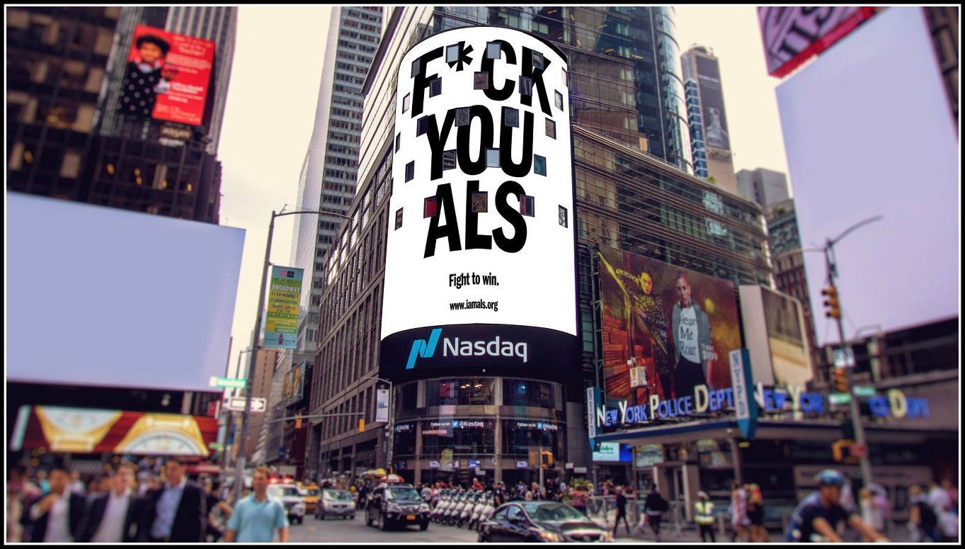
Patient demand
Petitions, congressional hearings, social media campaigns, awareness campaigns heat up
Demand is for expanded access, and govt funds to cover it

Slide 8
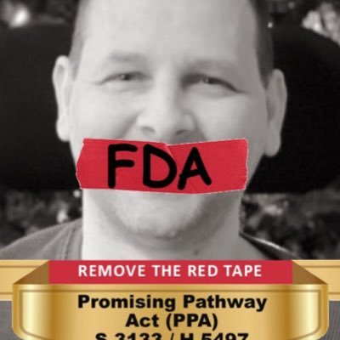
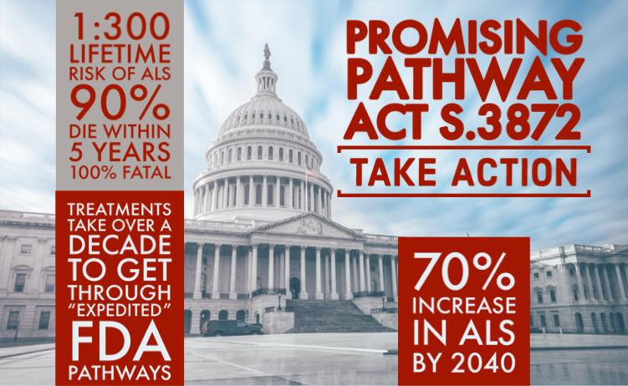
Proposed solution?
The Promising Pathway Act requires the FDA to establish a rolling, real-time, priority review pathway to evaluate provisional approval applications for drugs intended to treat, prevent, or diagnose serious or life-threatening diseases or conditions. Under the Promising Pathway Act, provisional approval is granted by the FDA to drugs demonstrating substantial evidence of safety and relevant early evidence of positive therapeutic outcomes.
So, expanding access to not-yet approved drugs for all who have the disease.
For patients, hope is that maybe the drug works and they can use it before it’s too late.
And if provisionally approved, Medicare or insurance companies should probably cover costs
What’s not to like? Solves the problem, right?

Slide 9
Potential objections
Costs – could be huge, if FDA approval provisional will insurance companies pay? Will Medicare? If yes, is this efficient? If no, is this fair?
Effectiveness: 95% or more of clinical 3 trials fail, so this is costly “Hail Mary pass” with very low odds of success.
Lowers bar for pharma companies, could distort approach to R&D
Will flood market with ineffectiveness drugs, hurt people it is meant to help
Could make it harder to recruit for clinical trials
Weaponizes patient advocacy groups; peddling false hope
Undercuts FDA regulatory and protection role

Slide 10
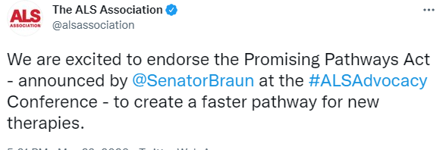
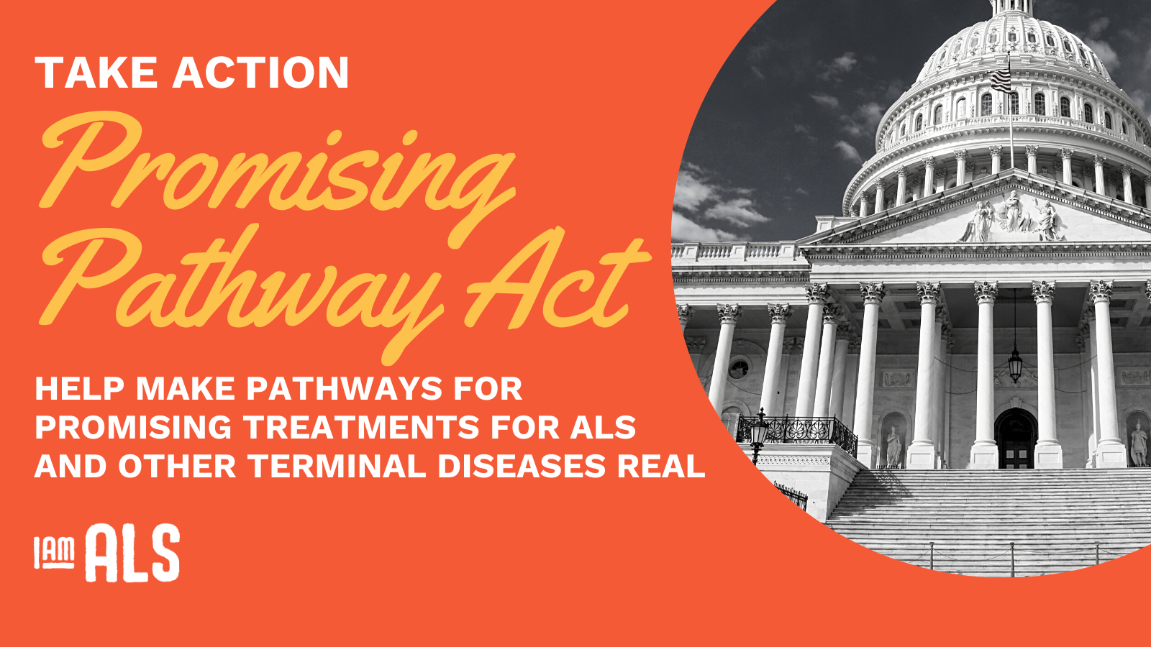
So what to do? Advocacy groups’ positions
ALS Association, Muscular Dystrophy Association, I AM ALS: vigorously support legislation
National Organization for Rare Diseases (NORD): opposes. “this legislation, by its own terms, would lower FDA’s approval standards, exposing patients to unsafe and ineffective medicines. Rare disease patients deserve access to innovative, safe, and effective medicines. NORD will continue to advocate for productive ways to fulfill this goal. In keeping with NORD’s mission to promote the best interests of the rare disease community, we will fight to ensure this bill does not become law.”

Slide 11
Others?
Politicians – many embracing but not acting
Medical ethicists – most oppose
Public health experts – most oppose
Pharmaceutical companies – most like, but not all
Ideologues of the left and right (meant in a nice way!)
You?
Me? The dilemma of patient advocacy; advocating for the greater good or the interest group; advocating for current or also future patients
The absence of dispassionate policy analysis; only advocacy voices
Wider lessons from the case study?

