Slide 1
Theories of the Policy Process: Multiple Streams Theory
POL 180
Intro to Policy Analysis
Fall 2021

Slide 2
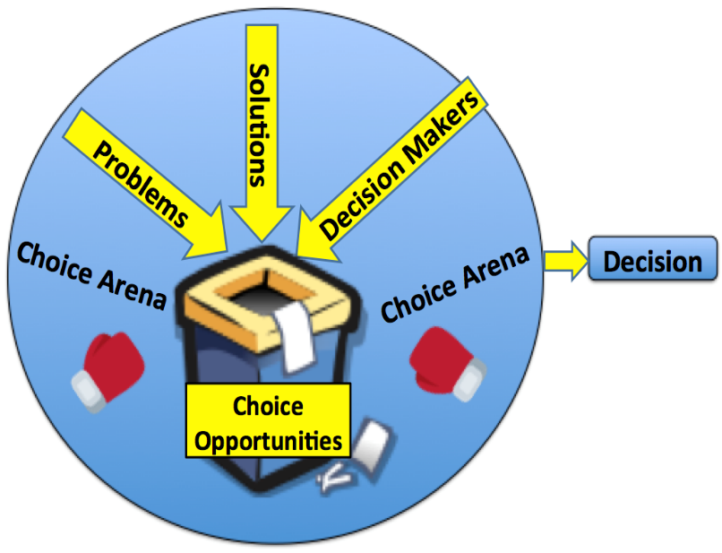
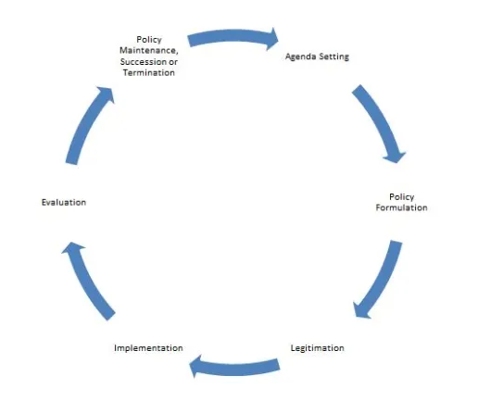
“Garbage can model:” competing metaphor to the policy cycle
Precursor to Multiple streams framework
Policy process as “organized anarchy”
1. Problematic preferences
2. Unclear technologies
3. Fluid participation
Multiple streams

Slide 3
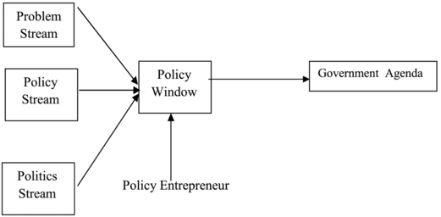
Multiple Streams Framework
Key features
Organized anarchy
Notion of three independent streams
Policy window of opportunity
Policy entrepreneurs
Policy output of less interest than process

Slide 4
Assumptions
Ambiguity (note: not same as uncertainty)
Time constraints
Problematic policy preferences
Unclear technology
Fluid participation
Stream independence

Slide 5
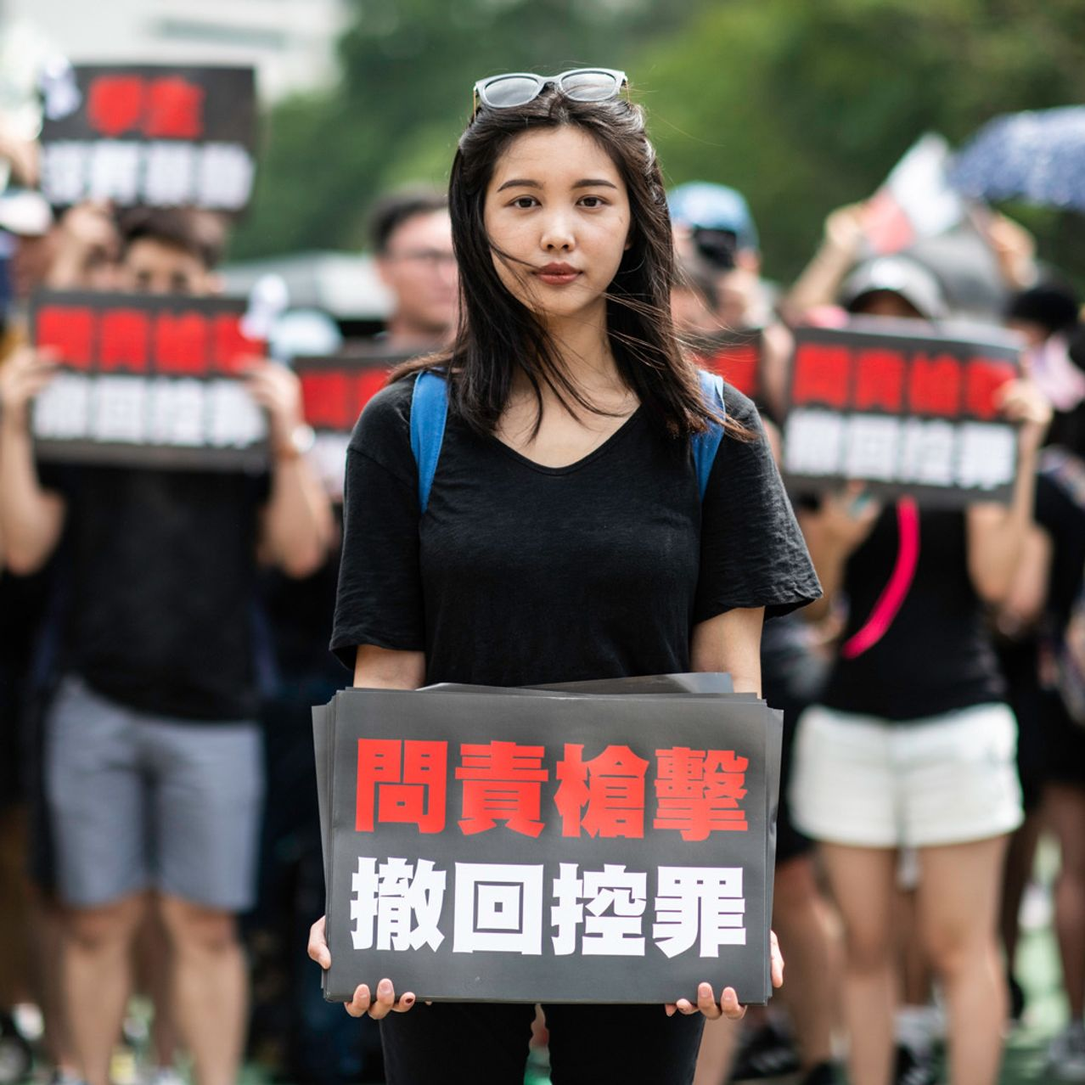
Problem stream
What is a problem? problems as social constructs; it’s a problem when we view it as a problem
Clashing perspectives
Focusing events
Problem brokers

Slide 6
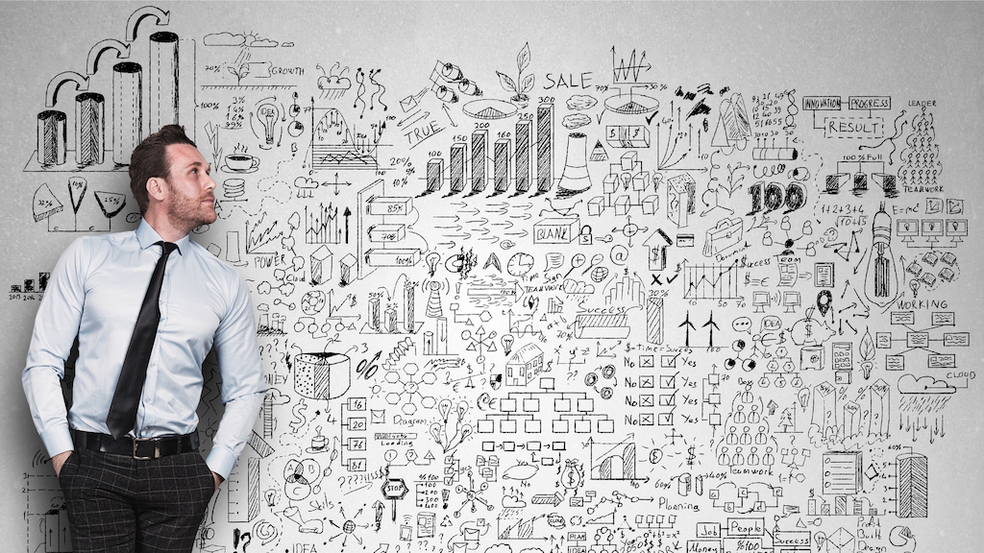
Policy Stream
Actors? The policy wonks!
“Primeval soup” of policy proposals
“Softening up” process
Criteria for survival – feasibility, value acceptability, public acquiescence, financial viability

Slide 7
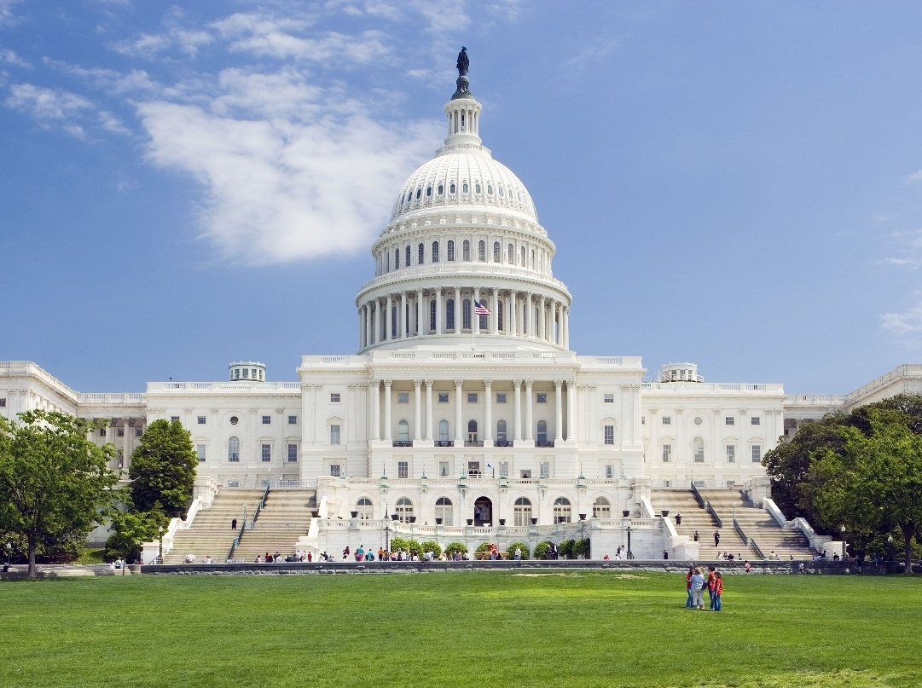
Political Stream
Basically, all our American politics courses…
Agenda-setting
Interest groups
National mood
Issues impacting re-election

Slide 8

Agenda (Policy) window
Coupling
Policy Entrepreneurs
Policy Implemented

Slide 9
Assessment?
What does theory clarify? What does it obscure?
How well does it explain change?
How well does it explain policy process globally? In private sector? Non-profit sector?
Role of political analysis? Political advocacy?
Similarities and differences with other theories we have read?

