Slide 1
Reputational Risk Assessments
POL 180
2021

Slide 2
Reputational Risk Assessments
Warren Buffett: “It takes 20 years to build a reputation and five minutes to ruin it.”
Polarization + social media = new, highly fraught operating environment
Definition: reputational risk refers to the potential for negative publicity, public perception or uncontrollable events to have an adverse impact on the reputation of a firm, non-profit, or government agency and its ability to operate.
Emphasis on unpredictability. Assess.
Usually risk of damaged reputation, but sometimes opportunity for improved reputation – examples from Davidson?
Sources of reputational damage: scandals, lawsuits, poor performance, corruption, bad reviews, social media attacks (fair or unfair), employee misbehavior, comedians?!
Types of reputational risk work:
Reputational risk assessments (“if we do this, what are the risks?”)
Reputation monitoring (surveys, brand image)
Reputation management (during a crisis; damage control)
Reputational repair (post-crisis: can carry its own risks)

Slide 3
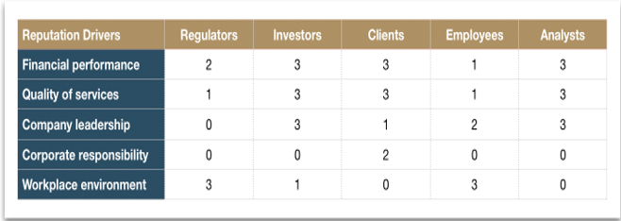
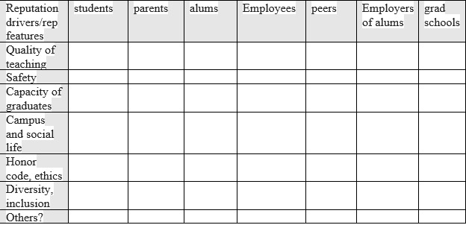
Does reputation matter? How to measure, place a value on it?
“firm’s most cherished asset”
“Residual thinking”
Which entities are more sensitive to reputational damage? Less sensitive? Why?
Examples of damaged reputations recently? Govt? non-profit? Private sector?
Davidson college cases
Wells-Fargo case
FFTC case
VW “Diesalgate”
Long term impacts?

Slide 4
Political Risk Analysis
POL 180
20121

Slide 5
What is risk analysis?
Definition: “includes risk assessment, risk characterization, risk perception, risk communication, risk management, risk governance, and policy relating to risk, in the context of risks of concern to individuals, to public and private-sector organizations, and to society at a local, regional, national, or global level. Risk analysis addresses both negative (undesirable) and positive (desirable) consequences, but the main focus of the present work is on the negative part.”
Risk assessment -- pulling together of all analytic inputs to determine level and nature of risks in a proposed policy or investment.
Risk perception – not empirical, but perceived risks, important for shareholders, voters, etc.
Risk management – systems to respond to and reduce risks, mitigate impact of failed risks
Risk governance – who is charged to decide to take risks and respond to risk
Risk tolerance – degree of acceptance of different levels of risk
Risk aversion – low tolerance for risk; very common
Risk-reward ratio – odds that risk will yield tangible benefit, key for assessing whether risk is worth it
Risk, reward, and responsibility – ethics (what is impact of failure?)
Risk and distribution of impact (who shoulders the burden of the risk?) (note big difference between for profit, govt, non-profits)
Probability - likelihood of outcome, expression of uncertainty
Worst case outcomes
Liability – costs for taking ailed risks the costs of which are borne by others
Reputational risk – negative publicity adversely affecting public perception of entity

Slide 6
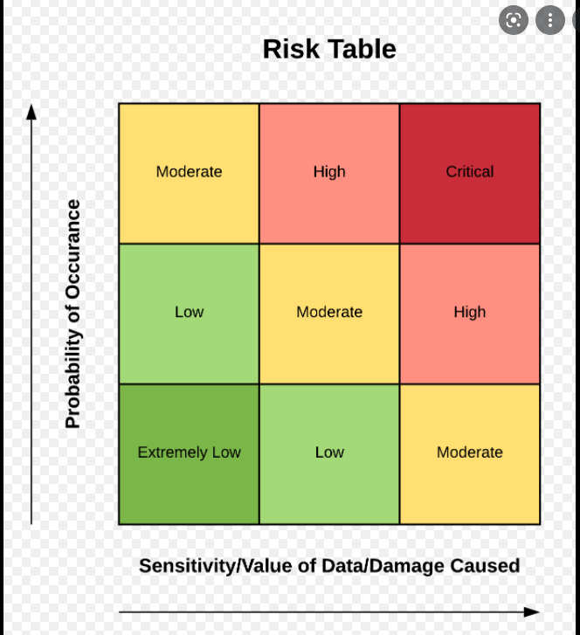
Main takeaways from readings?
Risk analysis is ubiquitous in all policy analysis and strategy
Very inter-disciplinary
Combines qualitative and quantitative inputs, judgement calls, predictive and trend analysis
Requires knowledge of both underlining and precipitating causes
Cannot be disconnected from risk-reward calculation
Risks must also be assessed in light of effectiveness of risk management options
Risk analysis must privilege close contextual knowledge
Is and must be theory-based.

Slide 7
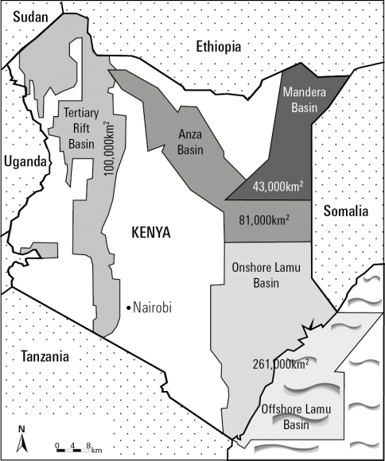
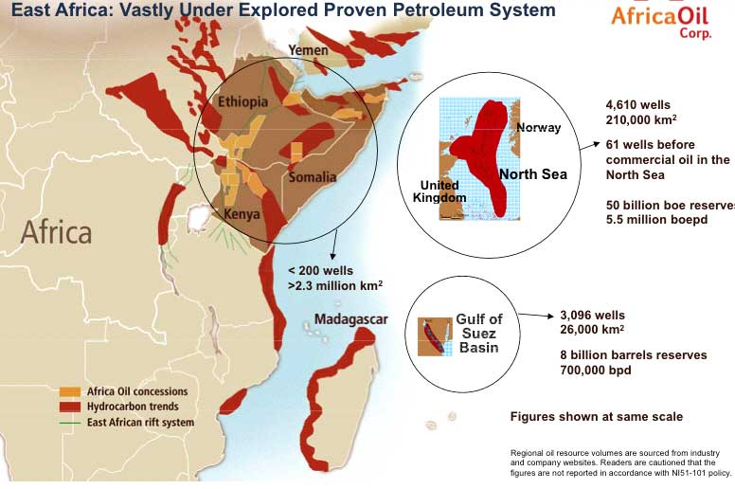
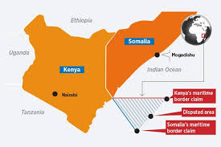
Case Study: East African hydrocarbons

Slide 8
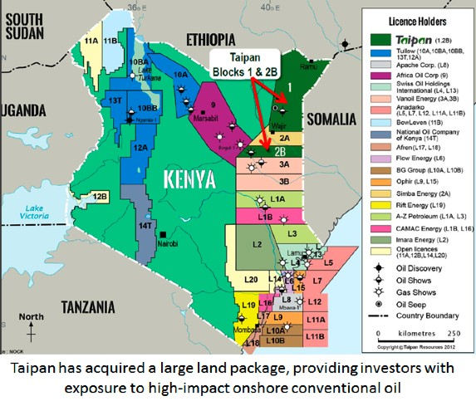
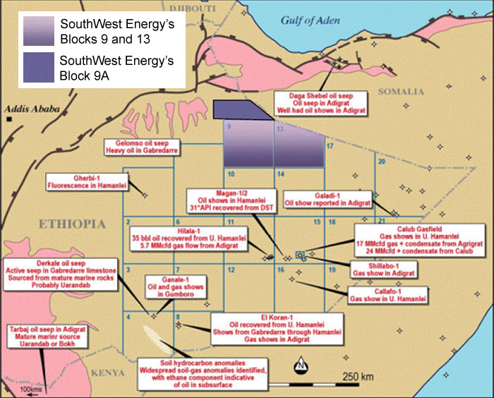
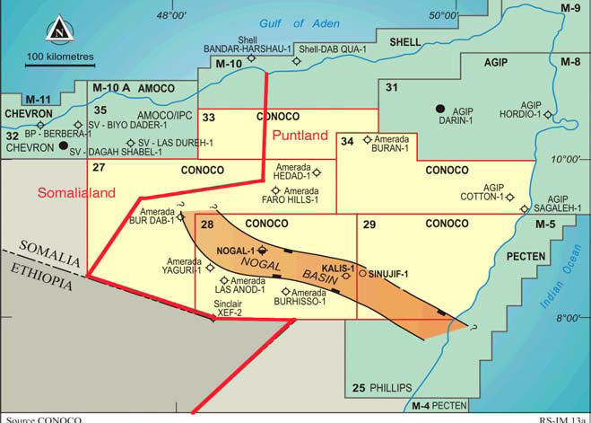
Concessions

Slide 9
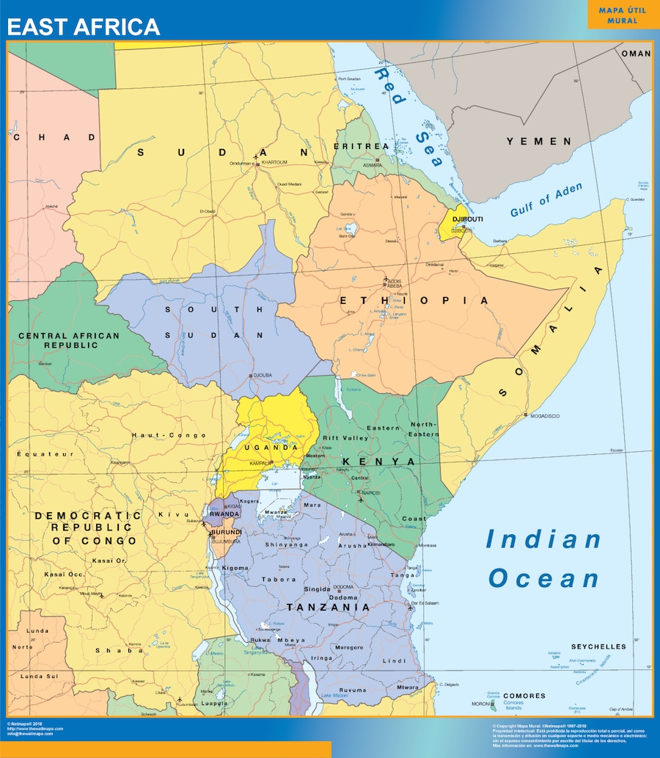
Background
East Africa as “Last hydrocarbon frontier”
“Junior and heavyweight players” in the game – “wildcats”
Peripheries, oil fields, power shifts, and risk

Slide 10
Control Risk conclusion?
Complex environment, requires forward planning
Heavy reference to problems experienced in Uganda as indicative of whole region – political interference, corruption, slow decisions, outdated laws, weak institutions
Chief impediment: East African governments
Risk level? Doesn’t say (gives more detail in country snapshots)

Slide 11
Assessment of the Control Risks risk analysis
Strengths?
Strong assessment of govt weaknesses
Good assessment of local-central government disputes
Weaknesses?
Little consideration of risks of regime changes
Little consideration of election violence
No mention at all of Al Shabaab! Terrorist attacks on installations
Minimal discussion of legal disputes over concessions
No blame for any problems on companies, including lack of situational awareness, technocratic approach
No economic trend assessment – global price of oil
Is region-wide assessment useful? Or is country based assessment better?

Slide 12
Risks for host country
government inexperience, produces fraught, acrimonious relations, dependence on foreign advisors
fears of neo-colonialism, MNCs capacity to interfere in politics;
tax evasion;
civil society pressures;
decentralization and competing govt authorities;
contested claims in border areas;
old concessions and force majeure;
corruption;
“Dutch disease”
Heightened political violence over “rentier economy”

Slide 13
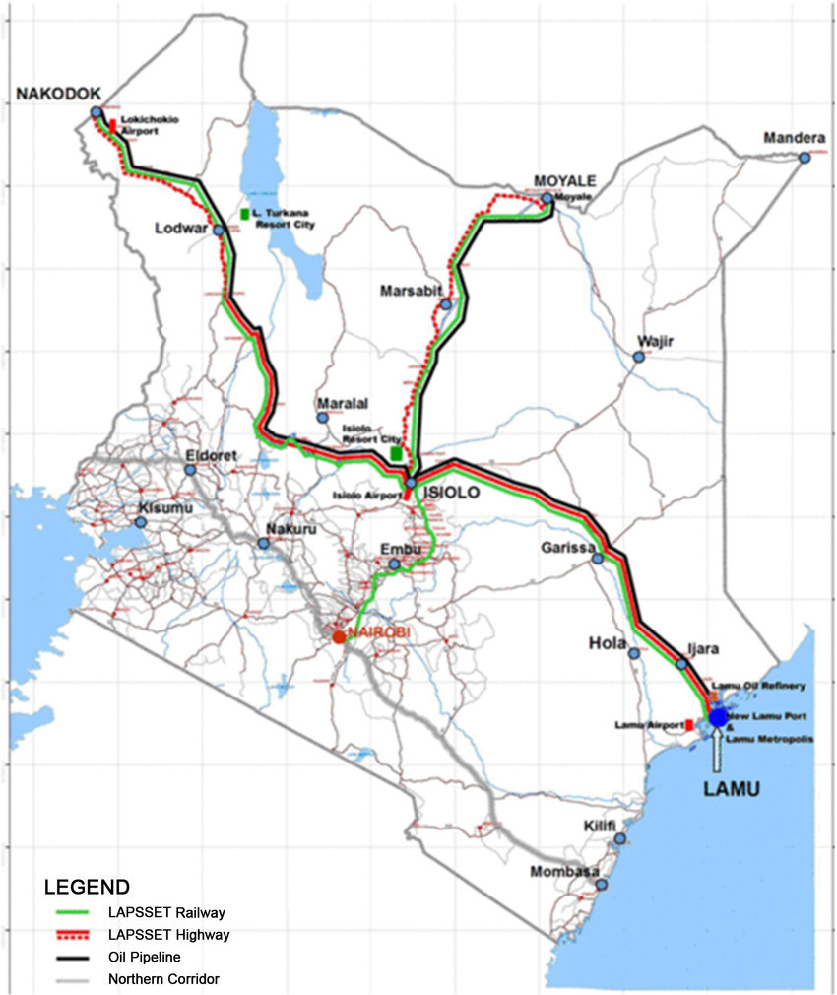
Risks to companies
unexpected expenses and delays;
sunk costs and bargaining leverage;
local disputes, resistance, violence, kidnapping;
insurgency/terrorist attacks;
awarding of multiple concessions, legal battles;
costs of corruption;
weak rule of law, unpredictability;
accusations oil production is reinforcing corruption and authoritarianism, harming locals (reputational risk);
Weak infrastructure;
threat of nationalization;
fluctuations in oil prices.

Slide 14
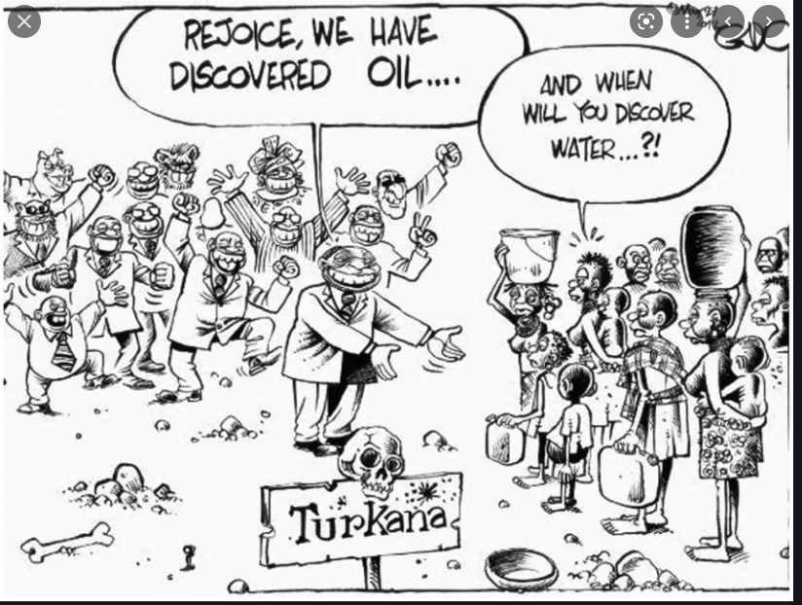
Risks to local communities
Land confiscation
Land-grabbing
Outsiders grabbing jobs, contracts
Inflation and scarcity
Environmental degradation
Loss of royalties
Intra-communal clashes
Corruption

