Slide 1
Policy advocacy briefs
POL 180
Fall 2021

Slide 2
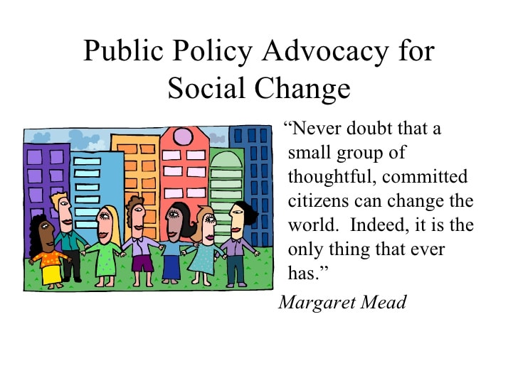
What is policy advocacy?
…the deliberate process of informing and influencing decision-makers in support of evidence-based policy change and policy implementation, including resource mobilization.
requires planning and strategy. It is not effective if done haphazardly.
…aims to inform and influence those who have the formal power to make a change.. The ultimate goal of policy advocacy is to achieve a desired policy change or ensure that an existing policy is implemented.
Can involve mobilization of stakeholders, media; networking and coalition-building.

Slide 3
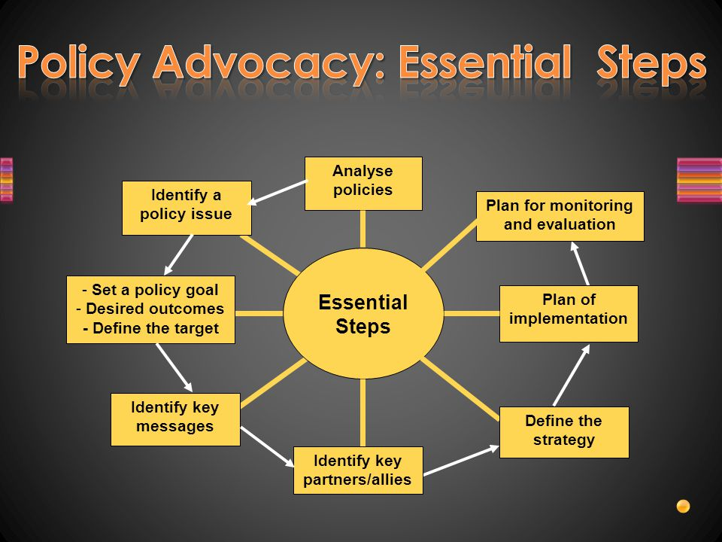
Where do policy advocacy briefs fit into policy advocacy?
As a tool -- of education, persuasion, framing, and mobilization: Provides succinct, persuasive problem statements and recommended policy change
Targets stakeholders, media, decision-makers

Slide 4
policy advocacy briefs and policy analyses
Can be separate endeavors, or sequential
Analyses focus more on assessment and options; advocacy mostly on urgency of problem and recommended course of action
Analysis is dispassionate; advocacy is passionate
Analysis weighs evidence; advocacy harnesses evidence

Slide 5
What makes for a good policy advocacy brief?
Should be simple, eye catching, readable, quotable, and have emotional appeal as well as evidence. Why the mix? Need evidence for credibility; but need emotion for action
For public debates, “if you’re explaining, you’re losing”
Framing is key
Knowing your audience is key; public mobilization very different from advocacy on an issue handled by experts away from public awareness
Impact – the brief delivers outcomes, not just outputs.
Takeaways from “34 steps” reading?

Slide 6
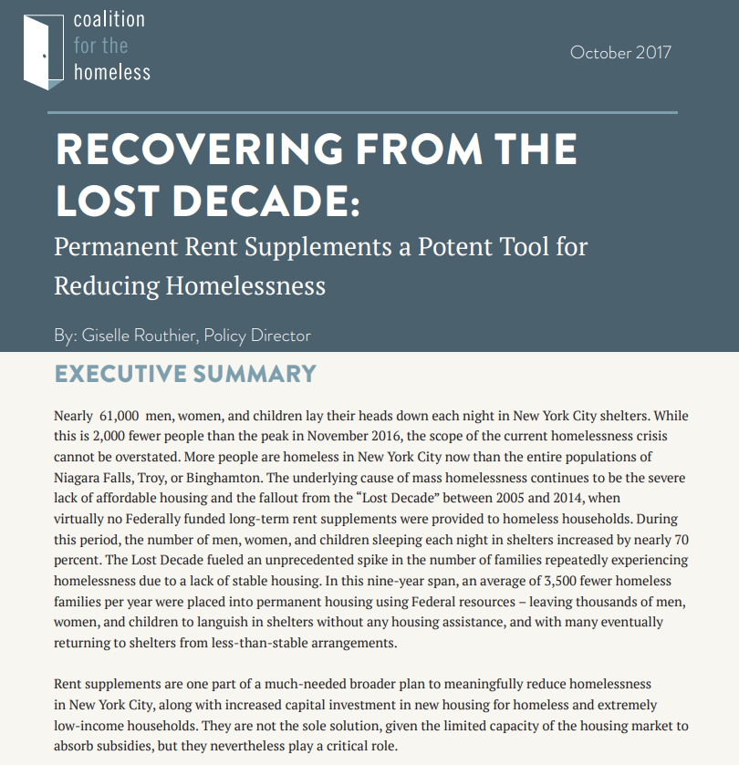
Case study: advocacy brief, Coalition for the Homeless
Assess effectiveness of first page – eye catching? Emotional appeal? Framing?
Who is the intended audience?

Slide 7
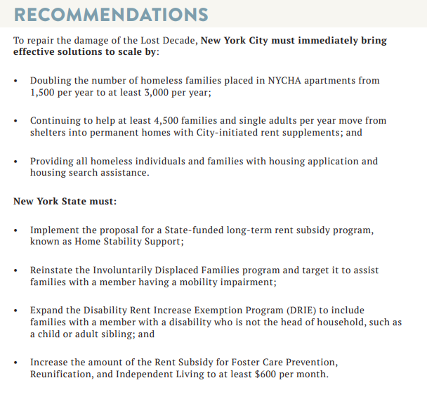
Assess recommendations
Persuasive? Clear? Substantial?
Feasible? Effective? Cost effective? Fair?
Linked to problem statement?
Assumptions?

Slide 8
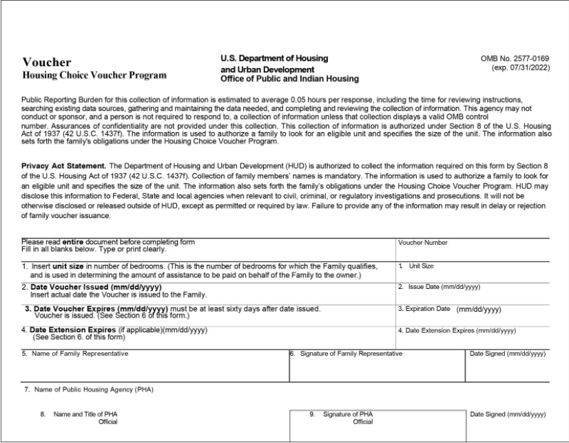
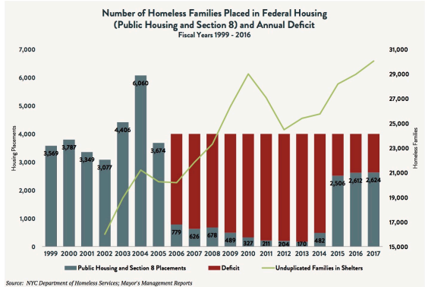
Assess the analysis
Consistent problem statement?
Does it anticipate and address potential objections to its proposal (expanding permanent rent supplements)?
Does it address problems of means-testing?
Were graphics compelling?
Did it address costs? Effectiveness? Cost effectiveness? Fairness? Other causes of homelessness?

