Slide 1
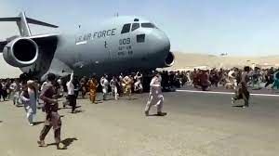
Hot policy case 2021: The withdrawal from Afghanistan
POL 180
Into to Policy Analysis

Slide 2
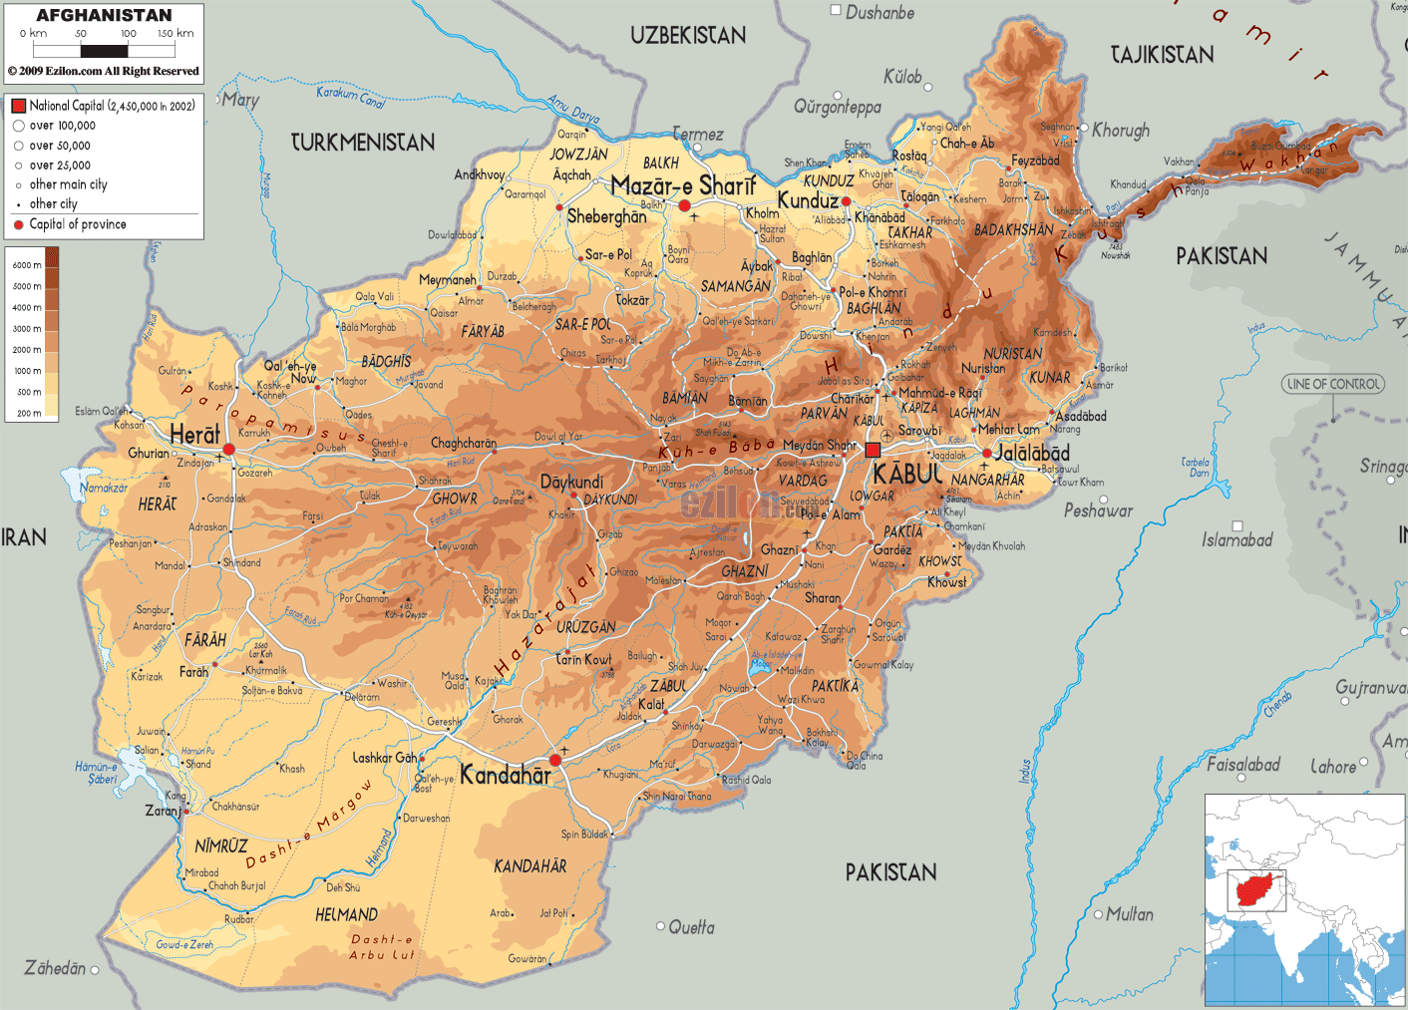
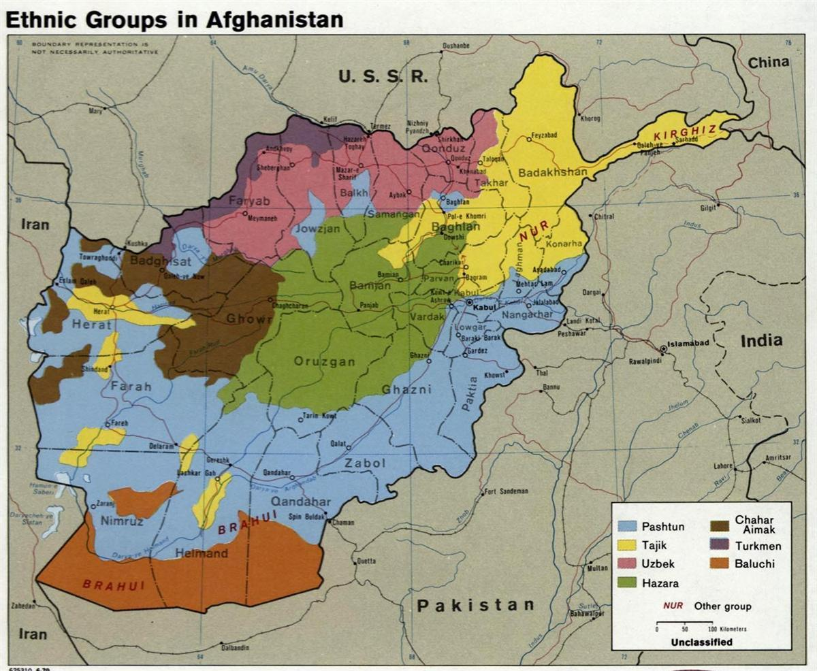
Background
America’s longest war, 2001-21 – cost: $2.3 trillion
Terrain
People, religion, culture
Geopolitics
Reputation: Graveyard of empires?
Soviet invasion of Afghanistan 1980s, mujahideen
US policy, 1980-92, and blowback
State collapse and civil war, 1992
Taliban rule, 1996-2001 and degree of popular support
Al Qaeda in Afghanistan and the 9/11 attack

Slide 3
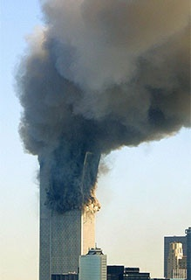
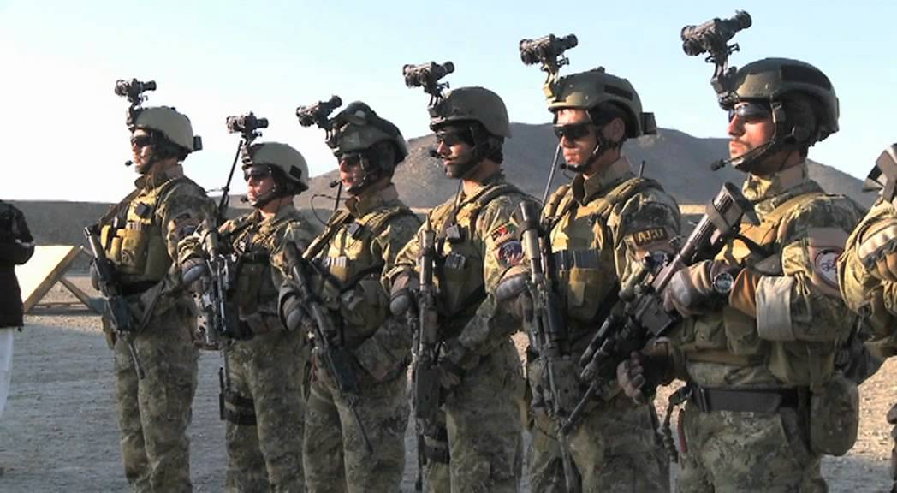
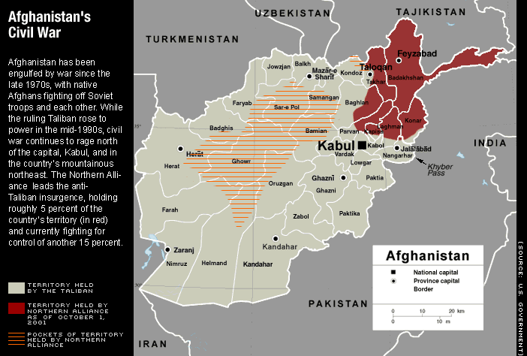
Post 9/11 US Policy toward Afghanistan
Demanded Taliban turn over bin Laden; it refuses
October air campaign, Operation Enduring Freedom
Ground campaign, Northern Alliance, CIA
Rapid Taliban retreat , collapse December 2001
Al Qaeda and Taliban flee to mountains; bin Laden escapes
US wins the war; can it win the peace?

Slide 4
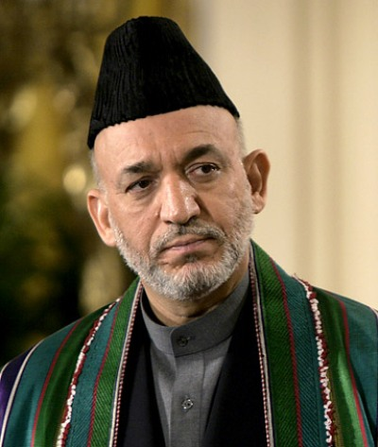
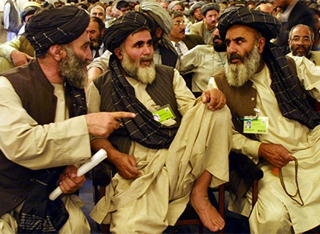
Challenges of winning the peace
Int’l peacekeepers, NATO
transitional govt challenges; corruption, tribalism, warlordism
COIN partnerships and dilemmas
Debates over effectiveness of US aid – billions wasted
2003 US shift to Iraq
Taliban advances, US reengages
Critique: Did we take our eye off the ball?
By 2006, most conclude war cannot be won
Path dependency
Political will
Uncertainty --CIA vs DOD assessments – the costs of politicizing analyses
Obama policy shift on Afghanistan – rhetoric and reality; DOD resistance

Slide 5
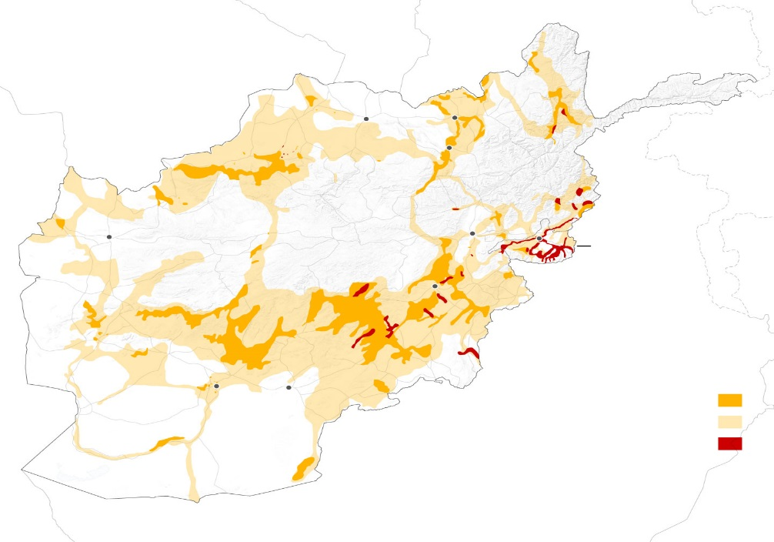
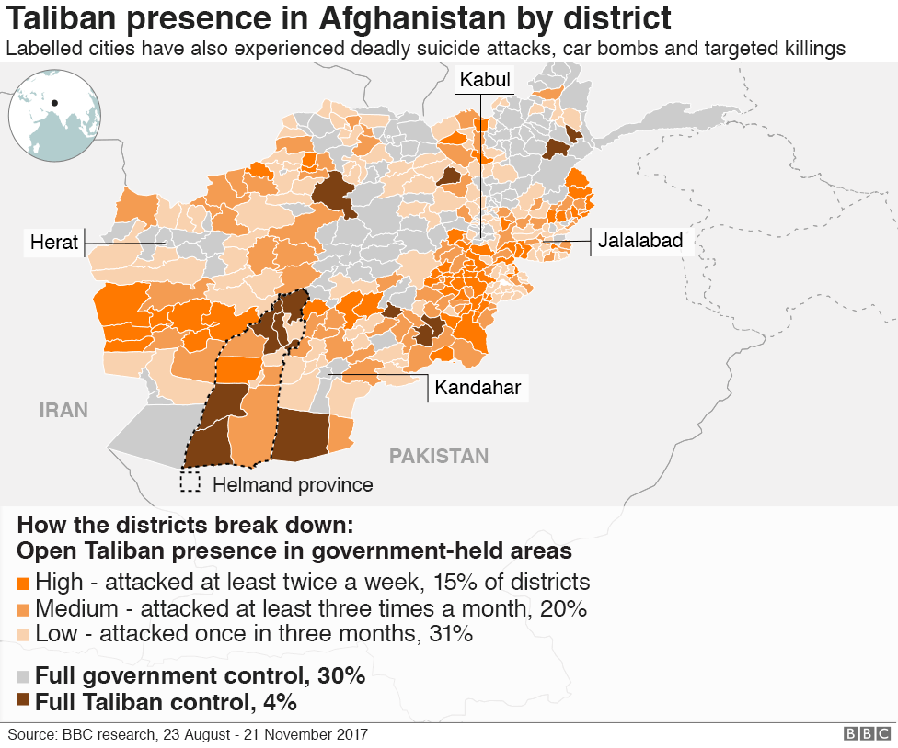
Afghanistan in 2018-2020
Conditions:
45-70% of country under Taliban control or contested
Spike in Taliban violence
Internal political crises; Kleptocracy
donor fatigue
Public opinion – wants out
Trump policy shift – negotiates deal with Taliban for US withdrawal by April 2021; inherited by Biden. Biden agrees, wants out too

Slide 6
The policy problem
The Trap -- war appears to be unwinnable, but leaving risks creating bigger problems than staying (security problems, political problems)
Public wants out; three presidents wanted out; foreign policy establishment split (what’s new)
Intelligence warned of Taliban takeover
Political problem – how to exit without taking blame if Taliban take over?

Slide 7
Biden’s options?
1. Keep medium size (5,000) force in key installations
2. Keep small force (2,500) in key installations
3. Maintain forces in Kabul only
4. Orderly withdrawal
Assumptions behind withdrawal:
Taliban would retake territory gradually, 18 months to Kabul
Afghan govt and security forces would remain intact
Route to airport would stay open

Slide 8
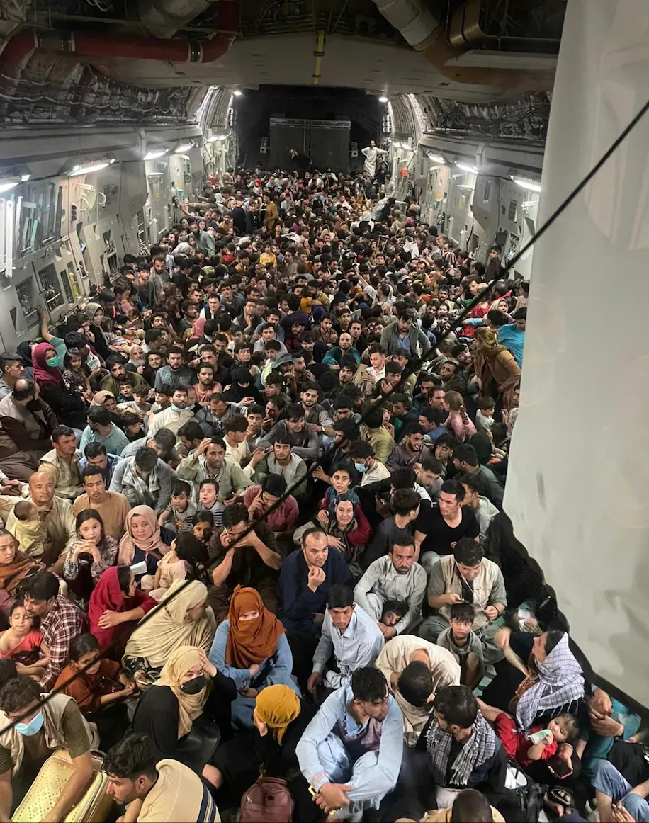
What goes wrong and why?
Rapid and complete collapse of Afghan govt
Taliban sweep into Kabul
Tribal leaders, militia leaders, govt officials all make deals with Taliban
Massive exodus, fear of reprisals
ISIS exploits, not part of deal, looking to attack US and embarrass Taliban

Slide 9
Assess two criticisms, using our tools
“…should not have withdrawn”
Sunk costs, commitment bias, reputational; political risk; cost-benefit analysis; forecasting; framing; politization of analysis; political calculations; groupthink; organizational politics (infighting); human rights; “sacrifices made in vain.”
2. “botched the withdrawal”
Intel failure? scenario building; wishful thinking; chaos theory; framing; reputational risk; political calculations.

