Slide 1
American Foreign Policy: Introduction to Key Theories and Concepts
POL 362
Spring 2022

Slide 2

Reminder!
This is just a short, introductory discussion of theories and concepts we will use and encounter over the course of the semester – not might to be comprehensive or in –depth treatment.
Read the Schmidt chapter as part of this presentation.

Slide 3

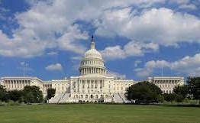
Where do these theories and concepts come from?
Study of US foreign policy at the intersection of three fields:
international relations theory
comparative foreign policy
American politics
As your Schmidt reading argues, this makes for exceptional complexity

Slide 4
Selected theories and concepts from international relations
Key theories
Realism, defensive (maximize security)
Realism, offensive (maximize power)
Liberalism
Hegemonic stability theory
Marxism and neo-Marxism
Constructivism
Key concepts
National self interest
Balance of power
Collective security
Mutual assured destruction
Rationality and sub-rationality
Interdependence
Hegemony
Multi-polarity
Imperialism and neo-imperialism
Political economy
Globalization
Norms

Slide 5
Comparative Foreign Policy
“Levels of analysis”
International system
Societal
Governmental
Bureaucratic
Individual
Key concepts and theories
Democratic peace theory
Interest group politics
Groupthink
Satisficing
Factionalism

Slide 6
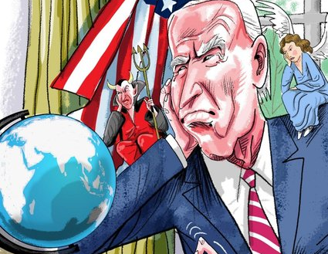
American Politics
Iron triangles
Separation of power
Checks and balances
Imperial Presidency
Executive orders
American exceptionalism

